Slide 1
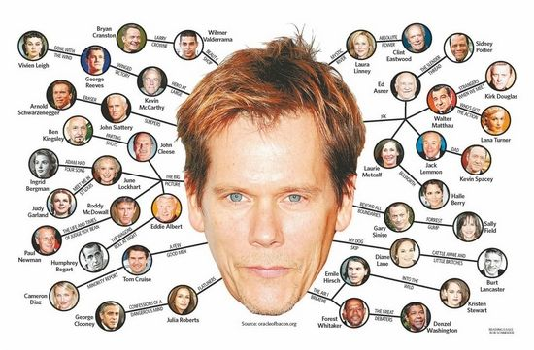
Graph Data Structures
"Unless in communicating with it [a computer] one says exactly what one means, trouble is bound to result. "
- Alan Turing
CLRS, Section 22.1

Slide 2
Definition
A graph G consists of two sets:
A finite, nonempty set of vertices V.
A finite, possible empty, set of edges E.
G(V,E) represents a graph.
G₁
0
1
2
3
V(G1)={0,1,2,3} E(G1)={(0,1),(0,2),(0,3),(1,2),(1,3),(2,3)}

Slide 3
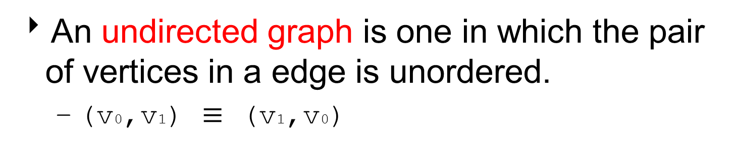
Definition
An undirected graph is one in which the pair of vertices in a edge is unordered.
(v0,v1) $≡$ (v1,v0)
G2
0
1
2
3
4
5
6
V(G2)={0,1,2,3,4,5,6} E(G2)={(0,1),(0,2),(1,3),(1,4),(2,5),(2,6)}

Slide 4
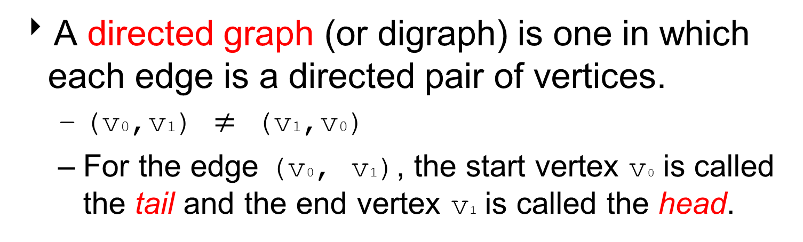
Definition
A directed graph (or digraph) is one in which each edge is a directed pair of vertices.
(v0,v1) $≠$ (v1,v0)
For the edge (v0, v1), the start vertex v0 is called the tail and the end vertex v1 is called the head.
tail
head
G3
0
1
2
V(G3)={0,1,2}
E(G3)={(0,1),(1,0),(1,2)}

Slide 5
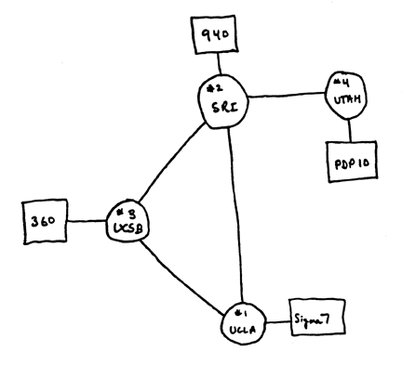
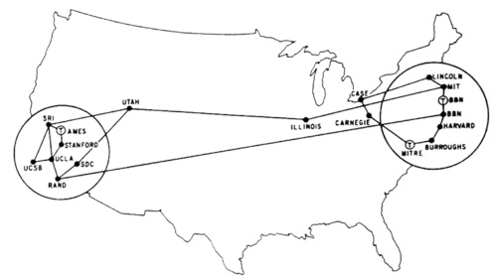
Example: Arpanet
Computer Scientists use graphs to model all kinds of things.
Arpanet 1969, 1971

Slide 6
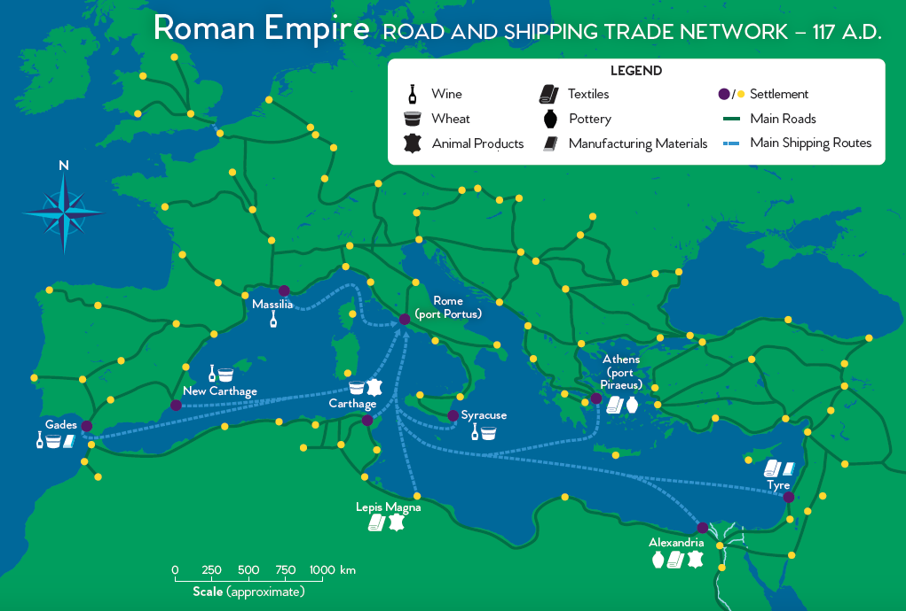
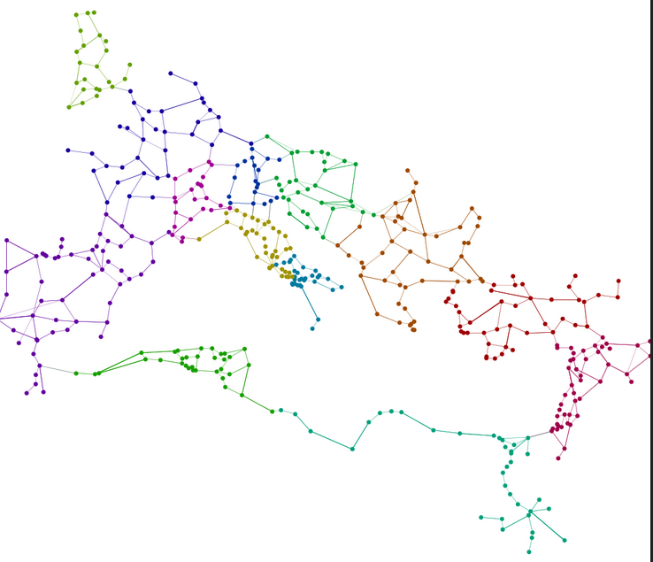
Example: Roman Trade Network

Slide 7
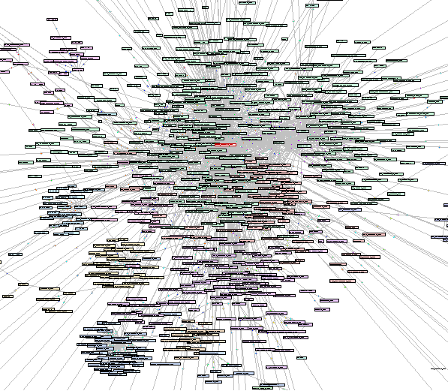
Example: Enron Emails

Slide 8
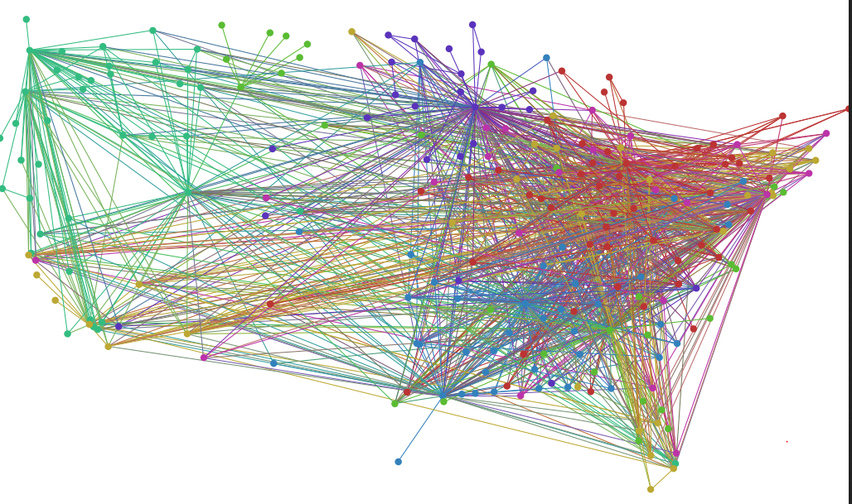
Example: US Airport Network

Slide 9
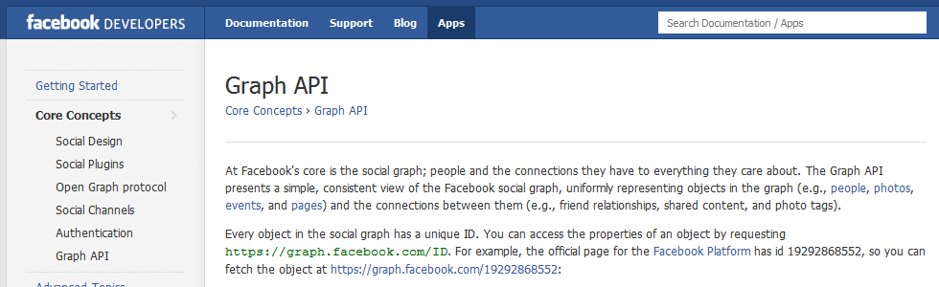
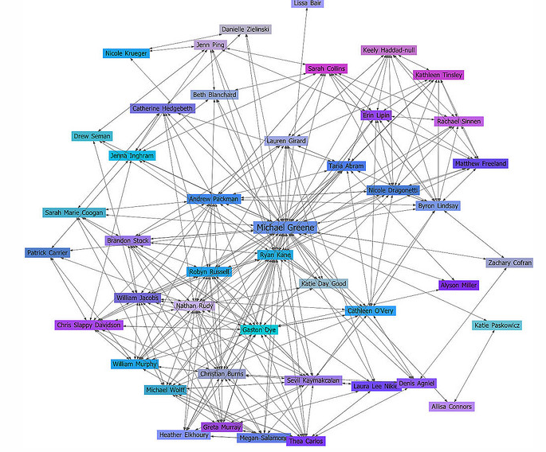
Example: Facebook

Slide 10
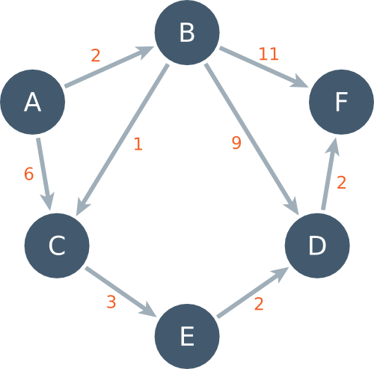
Graph Definitions
In a weighted graph the edge has cost or weight that measures the cost of traveling along the edge.

Slide 11
Paths and Cycles
A path is a sequence of vertices connected by edges.
The path length is the number of edges ( or number of vertices – 1).
The weighted path length is the sum of the cost of the edges in a path.
A simple path is a path in which all vertices are distinct (i.e. don’t repeat).
A cycle is a path of length 1 or more that starts and ends at the same vertex.
a directed acyclic graph (DAG) is a directed graph with no cycles.

Slide 12
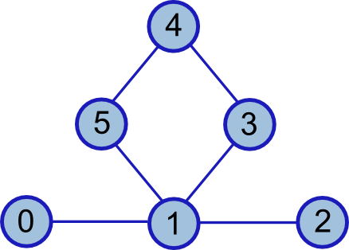
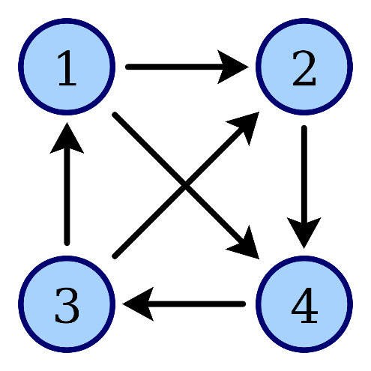
Connected Graph
In a graph G, two vertices, v_{i} and v_{j}, are connected if there is a path in G from v_{i} to v_{j}.
A graph is connected if, for every pair of distinct vertices v_{i}, v_{j}, there is a path from v_{i} to v_{j}.

Slide 13
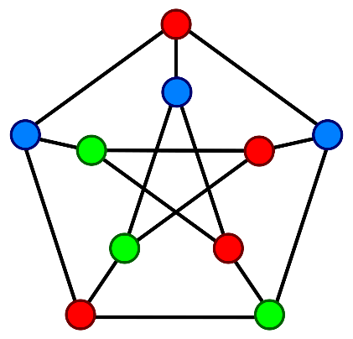
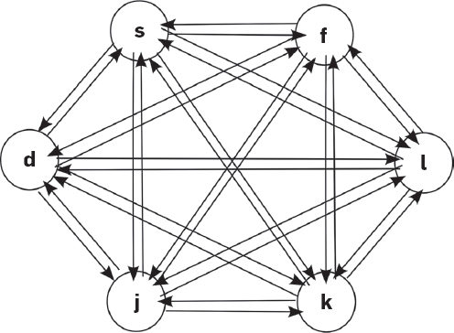
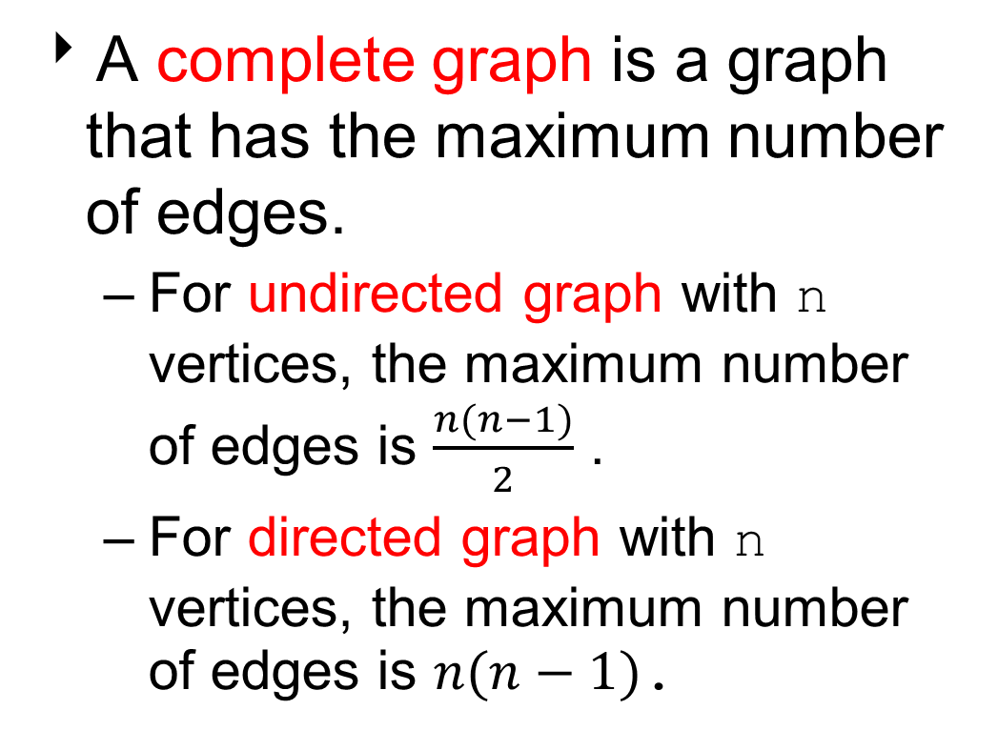
Complete Graph
A complete graph is a graph that has the maximum number of edges.
For undirected graph with n vertices, the maximum number of edges is $\frac{n(n−1)}{2}$ .
For directed graph with n vertices, the maximum number of edges is $n(n−1)$.

Slide 14
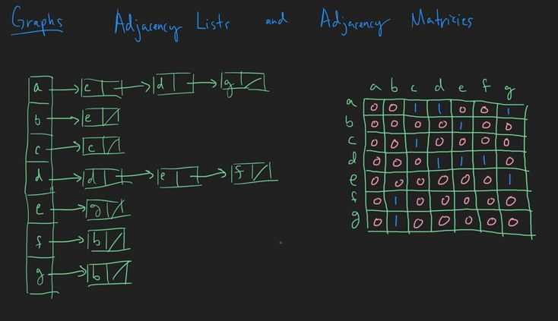
Representing Graphs
How to store a graph as a data structure?

Slide 15
Graph Representation
Adjacency Matrix
Adjacency Lists

Slide 16
Adjacency Matrix
Let G=<V,E> be a graph with |V| vertices.
The adjacency matrix of G is a two-dimensional |V|x|V| array, say matrix.
If the edge (vi, vj) is in E, matrix[i][j]= 1.
For weighted graphs, replace 1 with weight of the edge.
If there is no such edge in E, matrix[i][j]= 0.
The adjacency matrix for an undirected graph is symmetric
The adjacency matrix for a digraph need not be symmetric.

Slide 17
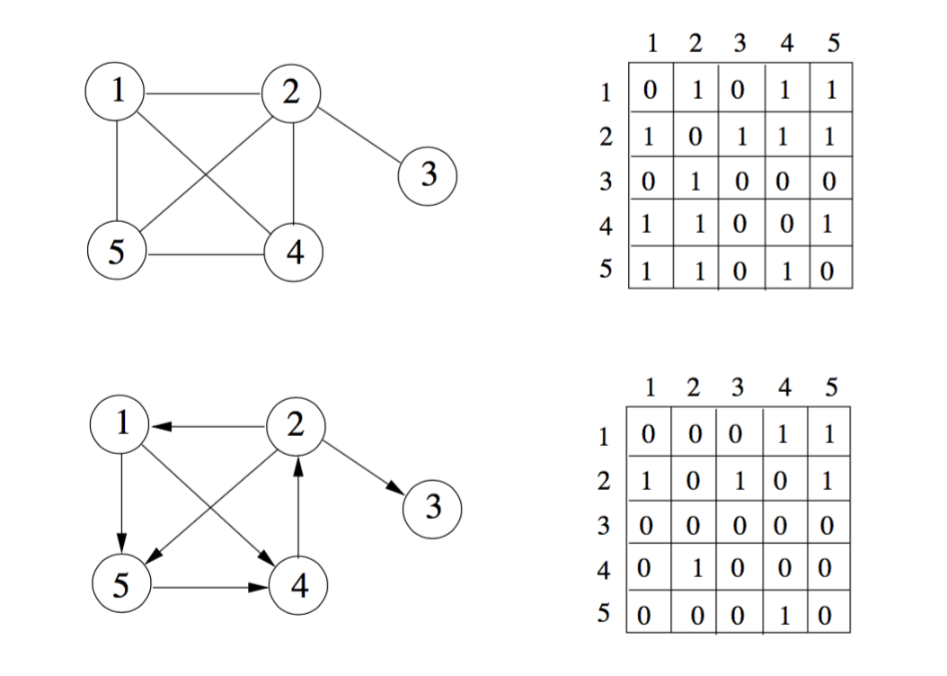
Example of Adjacency Matrix
For undirected graphs the matrix is symmetric.

Slide 18
Analysis of Adjacency Matrix
In a graph with|E|edges and|V|vertices:
If the graph is undirected, the number of 1’s in the matrix is 2*|E|.
If the graph is directed, the number of 1’s in the matrix is |E|.
The amount of memory required is O(|V|²).
The cost of determining whether an edge (v_{i},v_{j}) belongs to the graph is O(1).

Slide 19
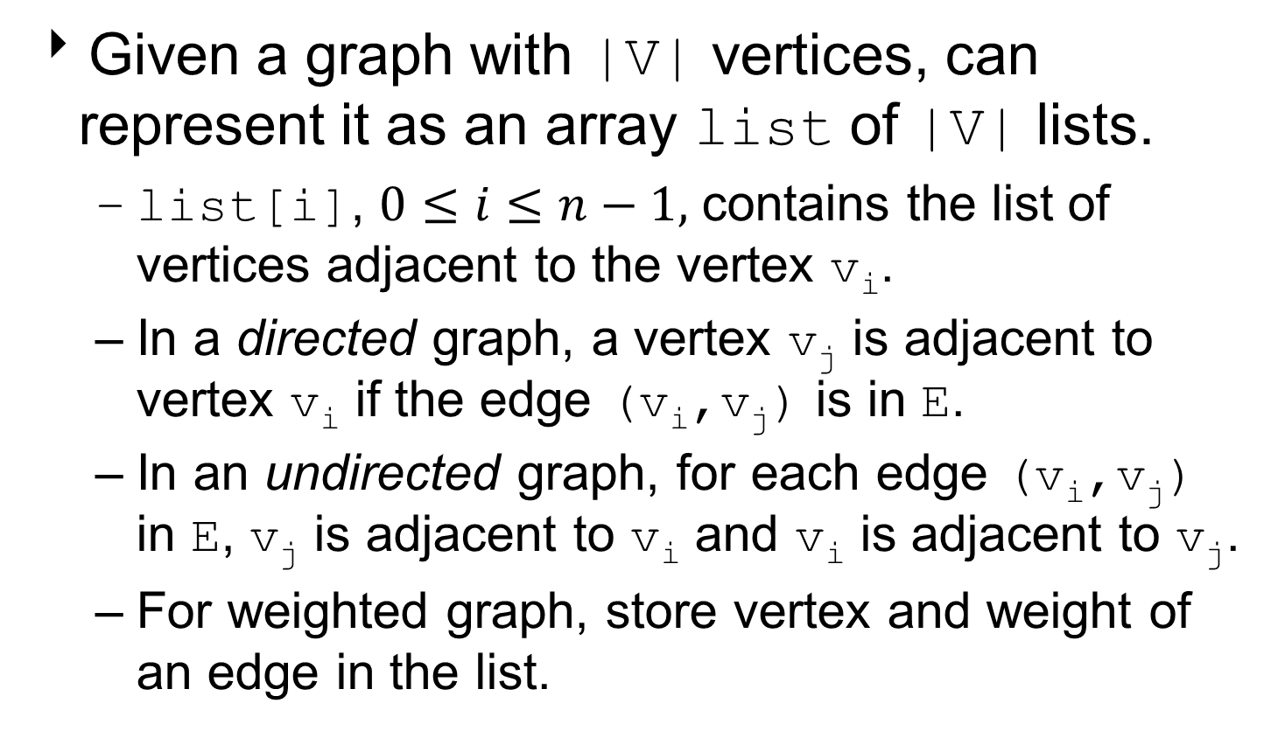
Adjacency List
Given a graph with |V| vertices, can represent it as an array list of |V| lists.
list[i], $0≤i≤n−1,$ contains the list of vertices adjacent to the vertex v_{i}.
In a directed graph, a vertex v_{j} is adjacent to vertex v_{i} if the edge (v_{i},v_{j}) is in E.
In an undirected graph, for each edge (v_{i},v_{j}) in E, v_{j} is adjacent to v_{i} and v_{i} is adjacent to v_{j}.
For weighted graph, store vertex and weight of an edge in the list.

Slide 20
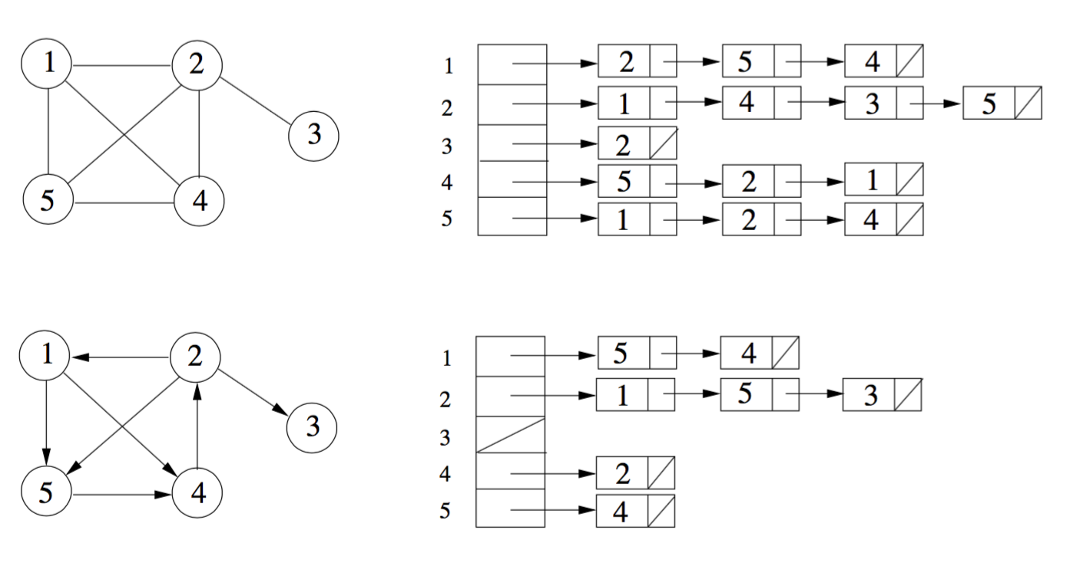
Examples of Adjacency Lists

Slide 21
Analysis of Adjacency List
In a graph with |E| edges and |V| vertices:
If the graph is undirected, the sum of the lengths of all lists is 2*|E|.
If the graph is directed, the sum of the lengths of all lists is|E|.
The amount of memory required for adjacency-list representation is O(|V|+|E|) for both directed and undirected graphs.
The cost to determine whether an edge (v_{i},v_{j}) belongs to the graph is O(|E|).

Slide 22
Sparse / Dense Graphs
In a dense graph, the number of edges is large.
Close to the maximum number of edges.
In a sparse graph, the number of edges is much less than the maximum possible number of edges.
No standard cutoff for dense and sparse graphs

Slide 23
Which Graph Representation?
For dense graphs, the adjacency matrix is more efficient.
Most of the matrix contains useful information.
But most graphs are sparse, not dense.
For sparse graphs, an adjacency list is more efficient.
No wasted space.

Slide 25
Early Graph Theory Problem
Leonhard Euler (1707 - 1783)
One of the first mathematicians to study graphs.
The Seven Bridges of Konigsberg Problem
A puzzle for the residents of the city.
The river Pregel flows through the city.
Seven bridges cross the river.
Can you cross all bridges while crossing each bridge only once?

Slide 26
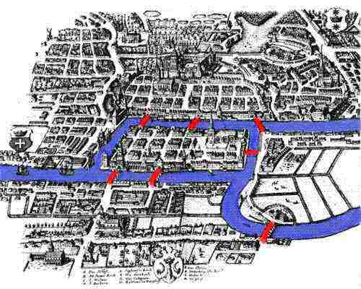
Konigsberg and the River Pregel

Slide 27
Question 1
How many solutions does the Seven Bridges of Konigsberg Problem have?
0
1
2
3
>= 4

Slide 28
Question 1
How many solutions does the Seven Bridges of Konigsberg Problem have?
0
1
2
3
>= 4

Slide 29
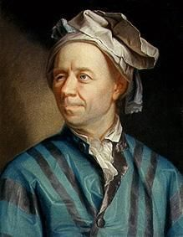
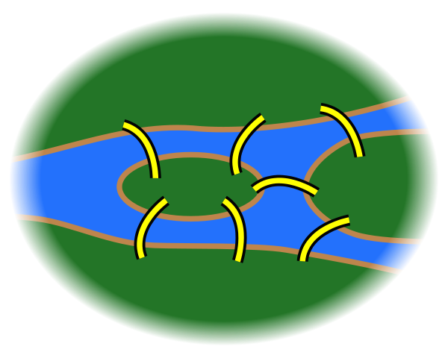
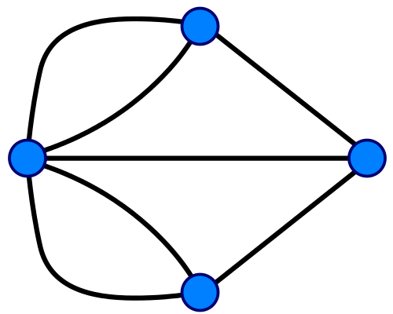
How to Solve?
Euler's Solution
Redraw the map as a graph.

Slide 30
Euler's Proposal
Euler Tour
Traverse each edge only once and return to starting point.
A connected graph has an Euler tour if and only if every vertex has an even number of edges.

Slide 32
Graph Implementation
public class Graph
private static final double INFINITY = Double.MAX_VALUE;
private Map<String, Vertex> vertices;
public Graph() // create empty Graph
public void addEdge(String source,
String dest, double cost)
// find all paths from given vertex
public void findUnweightedShortestPath
(String startName)
// called after findUnweightedShortestPath
public void printPath(String destName)

Slide 33
Vertex Class (nested in Graph)
private static class Vertex
private String name;
private List<Edge> adjacent;
public Vertex(String n)
// for shortest path algorithms
private double distance;
private Vertex prev;
private int scratch;
// call before finding new paths
public void reset()

Slide 34
Edge Class (nested in Graph)
private static class Edge
private Vertex dest;
private double cost;
private Edge(Vertex d, double c)

Slide 35
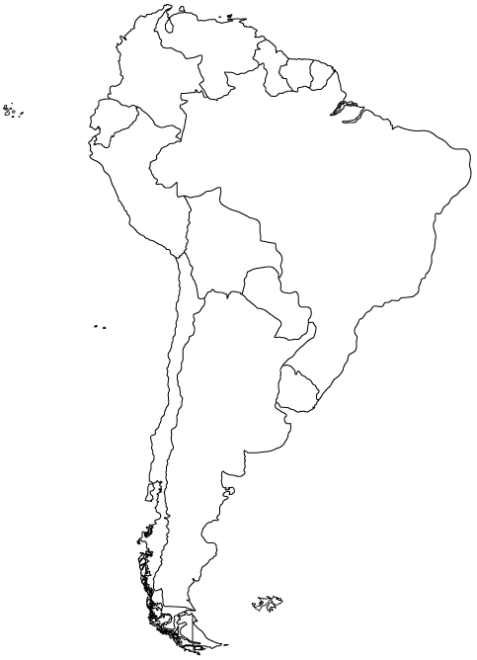
Representing a Map

Slide 36
Adjacency Matrix
A Br Bl Ch Co E FG G Pa Pe S U V A 0 1 1 1 0 0 0 0 1 0 0 1 0 Br 1 0 1 0 1 0 1 1 1 1 1 1 1 Bl 1 1 0 1 0 0 0 0 1 1 0 0 0 Ch 1 0 1 0 0 0 0 0 0 1 0 0 0 Co 0 1 0 0 0 1 0 0 0 1 0 0 1 E 0 0 0 0 1 0 0 0 0 1 0 0 0 FG 0 1 0 0 0 0 0 0 0 0 1 0 0 G 0 1 0 0 0 0 0 0 0 0 1 0 1 Pa 1 1 1 0 0 0 0 0 0 0 0 0 0 Pe 0 1 1 1 1 1 0 0 0 0 0 0 0 S 0 1 0 0 0 0 1 1 0 0 0 0 0 U 1 1 0 0 0 0 0 0 0 0 0 0 0 V 0 1 0 0 1 0 0 1 0 0 0 0 0
Country
Code
Argentina
A
Brazil
Br
Bolivia
Bl
Chile
Ch
Columbia
Co
Ecuador
E
French Guiana
FG
Guyana
G
Paraguay
Pa
Peru
Pe
Suriname
S
Uruguay
U
Venezuela
V

Slide 37
The Map Coloring Problem
How many colors do you need to color a map, so that no 2 countries that have a common border (not a point) are colored the same?
How to solve using Brute Force?

Slide 38
A Solution
Blue
Blue
Yellow
Yellow
Green
Blue
Green
Yellow
Red
Green
Blue
Yellow

Slide 39
What About the Ocean?
A Br Bl Ch Co E FG G Pa Pe S U V Oc A 0 1 1 1 0 0 0 0 1 0 0 1 0 1 Br 1 0 1 0 1 0 1 1 1 1 1 1 1 1 Bl 1 1 0 1 0 0 0 0 1 1 0 0 0 0 Ch 1 0 1 0 0 0 0 0 0 1 0 0 0 1 Co 0 1 0 0 0 1 0 0 0 1 0 0 1 1 E 0 0 0 0 1 0 0 0 0 1 0 0 0 1 FG 0 1 0 0 0 0 0 0 0 0 1 0 0 1 G 0 1 0 0 0 0 0 0 0 0 1 0 1 1 Pa 1 1 1 0 0 0 0 0 0 0 0 0 0 0 Pe 0 1 1 1 1 1 0 0 0 0 0 0 0 1 S 0 1 0 0 0 0 1 1 0 0 0 0 0 1 U 1 1 0 0 0 0 0 0 0 0 0 0 0 1 V 0 1 0 0 1 0 0 1 0 0 0 0 0 1 Oc 1 1 0 1 1 1 1 1 0 1 1 1 1 0

Slide 40
Make the Ocean Blue
Red
Yellow
Yellow
Red
Green
Red
Green
Yellow
Blue
Blue
Green
Red
Blue
Yellow

